Slide 1
ATTENDANCE MANAGEMENT SYSTEM
TS- WEB/CC/AI TRACK CAPSTONE PROJECT
Presented By:
1. S.pramoda
2. Ch.Sai Deekshitha
3.B.poojitha
4.K.Tejasree

Slide 2
OUTLINE
Abstract
Problem Statement (Should not include solution)
Aims , Objective & Proposed System/Solution
System Design
System Development Approach(Technology Used)
Algorithm & Deployment
Conclusion
References
Future Scope

Slide 3
Abstract
The Attendance Management System (AMS) is an advanced technological solution designed to simplify and optimize attendance tracking processes in various educational institutions, organizations, and workplaces. The primary objective of the Attendance Management System is to eliminate the conventional paper-based attendance recording methods, minimize manual errors, and enhance efficiency. The system incorporates biometric, RFID, or barcode-based identification methods to uniquely identify individuals, ensuring secure and tamper-proof attendance records.
Furthermore, the Attendance Management System can integrate with existing systems, such as student information systems or human resource management platforms, to synchronize data and enhance overall efficiency. This integration eliminates redundant data entry and ensures accurate information across multiple platforms.

Slide 4
Problem Statement
Attendance Management System is software developed for daily student attendance in schools, colleges and institutes. It facilitates to access the attendance information of a particular student in a particular class. This system will also help in evaluating attendance eligibility criteria of a student. By just a click on the mouse, the system will be able to produce the students' attendance report thus reducing the need for manual labour which is prone to human errors and time consuming.
This application is built for automating the processing of attendance. It also enhances the speed of performing attendance task easily.

Slide 5
Proposed Solution
To overcome the drawbacks of the existing system, the proposed system has been evolved. This project aims to reduce the paper work and saving time to generate accurate results from the student’s attendance. The system provides with the best user interface. The efficient reports can be generated by using this proposed system.
Advantages of Proposed System
It is trouble-free to use.
It is a relatively fast approach to enter attendance
Is highly reliable, approximate result from user
Best user Interface
Efficient reports

Slide 6
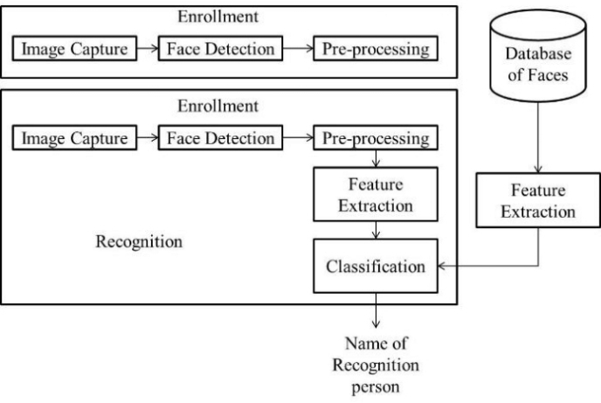
System Architecture

Slide 7
Conclusion
To conclude, Project Data Grid works like a component which can access all the databases and picks up different functions. It overcomes the many limitations incorporated in the attendance.
➢Easy implementation Environment
➢Generate report Flexibly

Slide 8
Future Scope
The project has a very vast scope in future. The project can be implemented on intranet in future. Project can be updated in near future as and when requirement for thesame arises, as it is very flexible in terms of expansion. With the proposed software of database Space Manager ready and fully functional the client is now able to manage and hence run the entire work in a much better, accurate and error free manner. The following are the future scope for the project.
➢Discontinue of particular student eliminate potential attendance.
Bar code Reader based attendance system.
Individual Attendance system With photo using Student login.

Slide 9
THANK YOU

